Slide 1
Progress Report (25th Week)
Presented by Credo
17/07/2020

Slide 2
Towards 3D Human Pose Construction Using WiFi
Wenjun Jiang, Hongfei Xue, Chenglin Miao, Shiyang Wang, Sen Lin, Chong Tian, Srinivasan Murali, Haochen Hu, Zhi Sun, and Lu Su
State University of New York at Buffalo, Buffalo, NY USA

Slide 3
MOTIVATION
What is Human Pose Estimation?
Human Pose Estimation is defined as
the problem of localization of human joints
(also known as keypoints - elbows, wrists, etc) in images or videos. Itis also defined as the search for a specific pose in space of all articulated poses.
Current problems
Occlusion
Bad illumination
Blurry
Privacy issues
Alexander Toshev and Christian Szegedy, “Deeppose: Human pose estimation via deep neural networks,” in Proceedings of the IEEE conference on computer vision and pattern recognition (CVPR), IEEE, 2014, pp. 1653–1660.

Slide 4
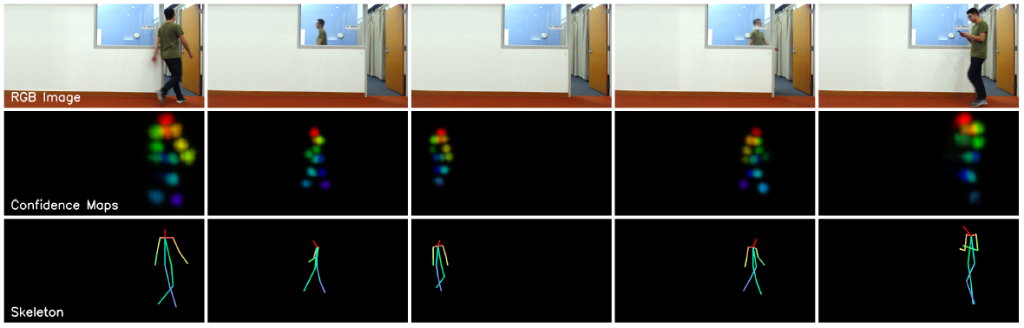
MOTIVATION
Pose estimation using WiFi
Monitoring the occluded targets
Low power comsumption
Mingmin Zhao, Tianhong Li, Mohammad Abu Alsheikh, Yonglong Tian, Hang Zhao, Antonio Torralba, and Dina Katabi. Through-wall human pose estimation using radio signals. In Proceedings of the IEEE Conference on Computer Vision and Pattern Recognition (CVPR). IEEE. 2018.

Slide 5
RELATED WORK
Human Pose Estimation using wireless singals
Signal Type | Work | Occlusion | Illumination | Privacy | Power | 3D | COTS
Visible Light Communication (VLC) | LiSense ^{[1]} | X | X | Y | Y | Y | X
 | StarLight ^{[2]} | X | X | Y | Y | Y | X
LiDAR | RS-LiDAR ^{[3]} | X | Y | Y | X | Y | X
Frequency Modulated Continuous Wave (FMCW) | RFPose ^{[4]} | Y | Y | Y | Y | Y | X
 | RFPose3D ^{[5]} | Y | Y | Y | Y | Y | X
Wi-Fi | Wang et. al. ^{[6]} | Y | Y | Y | Y | X | Y
 | WiPose | Y | Y | Y | Y | Y | Y
[1] Tianxing Li, Chuankai An, Zhao Tian, Andrew T Campbell, and Xia Zhou. Human sensing using visible light communication. In Proceedings of the 21st
Annual International Conference on Mobile Computing and Networking (MobiCom). ACM, 2015.
[2] Tianxing Li, Qiang Liu, and Xia Zhou. Practical human sensing in the light. In Proceedings of the 14th Annual International Conference on Mobile Systems, Applications, and Services (MobiSys), ACM, 2016.
[3] Zhe Wang, Yang Liu, Qinghai Liao, Haoyang Ye, Ming Liu, and Lujia Wang. Characterization of a RS-LiDAR for 3D Perception. In Proceedings of the 8th Annual International Conference on CYBER Technology in Automation, Control, and Intelligent Systems (CYBER). IEEE, 2018.
[4] Mingmin Zhao, Tianhong Li, Mohammad Abu Alsheikh, Yonglong Tian, Hang Zhao, Antonio Torralba, and Dina Katabi. Through-wall human pose estimation using radio signals. In Proceedings of the IEEE Conference on Computer Vision and Pattern Recognition (CVPR). ACM, 2018.
[5] Mingmin Zhao, Yonglong Tian, Hang Zhao, Mohammad Abu Alsheikh, Tianhong Li, Rumen Hristov, Zachary Kabelac, Dina Katabi, and Antonio Torralba. RF-based 3D skeletons. In Proceedings of the Conference of the ACM Special Interest Group on Data Communication (SIGCOMM). ACM, 2018.
[6] Fei Wang, Sanping Zhou, Stanislav Panev, Jinsong Han, and Dong Huang. Person-in-WiFi: Fine-grained Person Perception using WiFi. In Proceedings of the IEEE International Conference on Computer Vision (ICCV), IEEE, 2019.

Slide 6
CHALLENGES
Realistic-looking
Spatial rationality: logic between joint locations and angles
Spatial constraints
Solution: Posture Construction Process
Substantial information
Robustness to the dynamic environments
Solution: 3D Velocity Profile
Continuous and smooth
Temporal rationality: continuity and smoothness
Temporal constraints
Solution: RNN with a smooth loss

Slide 7
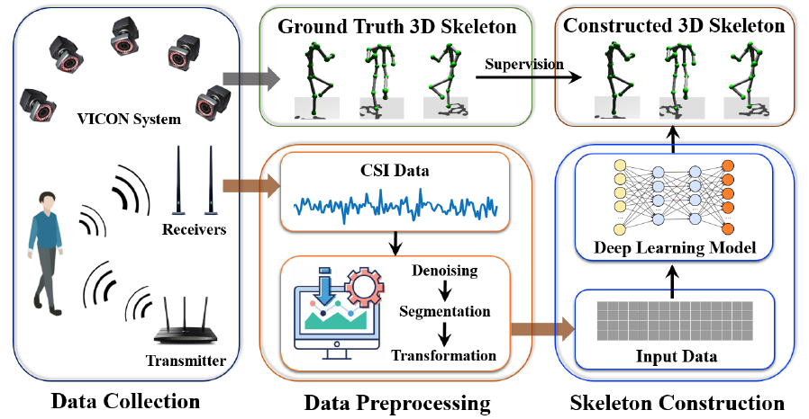
SYSTEM DESIGN
System overview

Slide 8
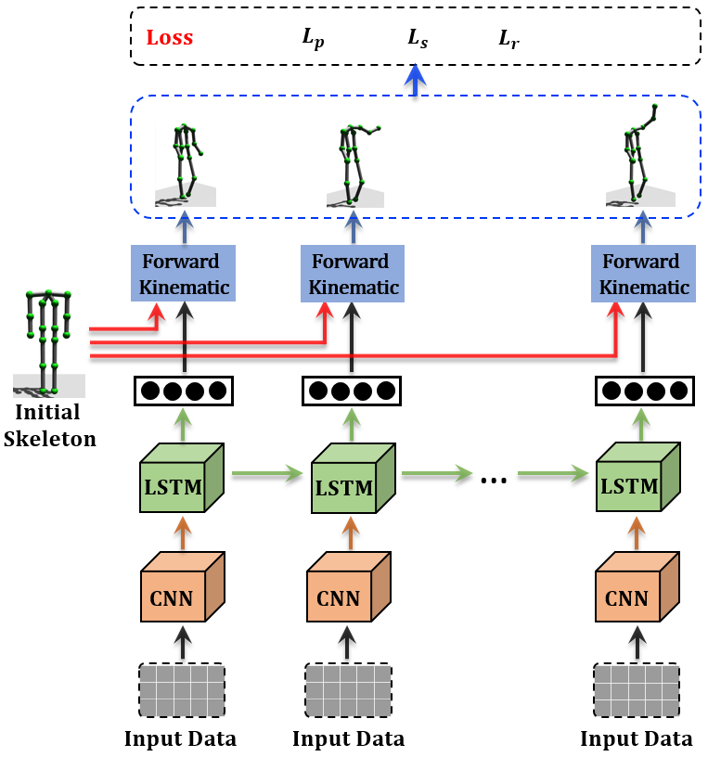
SYSTEM DESIGN
Pose estimation model
Smooth loss
Posture Construction Process
Temporal Feature Extraction
Spatial Feature Extraction

Slide 9
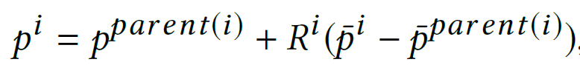
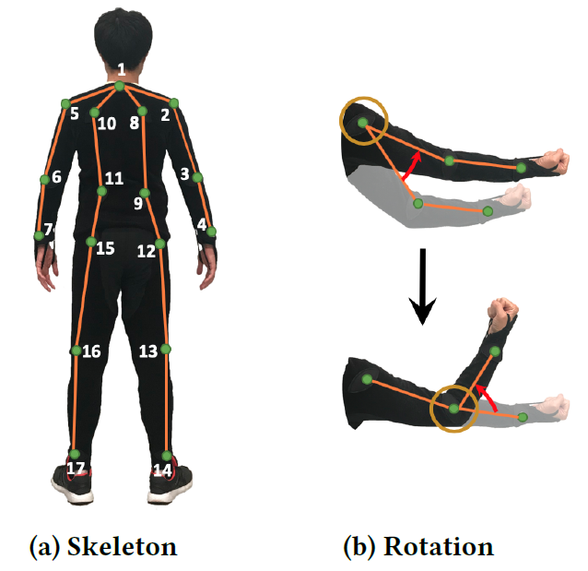
SYSTEM DESIGN
Posture Construction Process

Slide 10
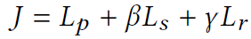
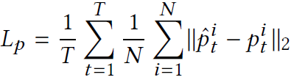
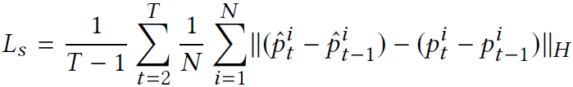
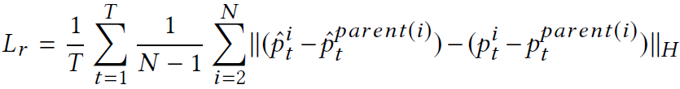
SYSTEM DESIGN
RNN with a smooth loss
Training
Basic loss:
Huber loss for smoothness:

Slide 11
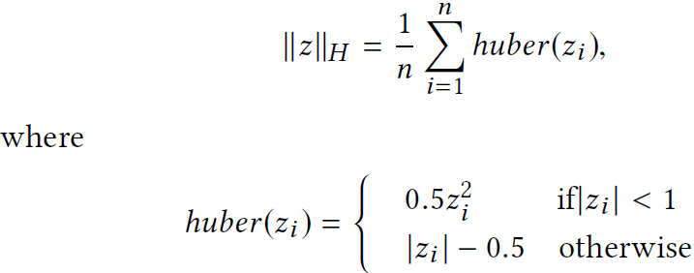
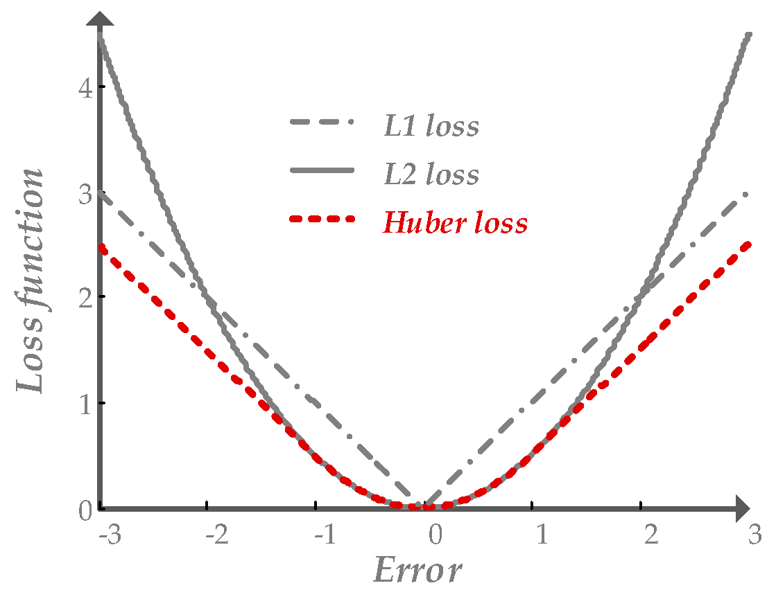
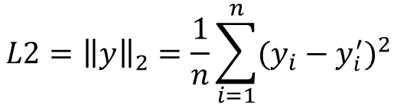
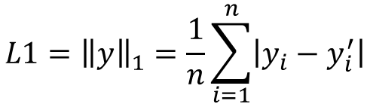
SYSTEM DESIGN
Huber Loss
$$L1={\left\|y\right\|}_{1}=\frac{1}{n}\sum_{i=1}^{n}{\left|y_{i}−y_{i}^{′}\right|}$$
$$L2={\left\|y\right\|}_{2}=\frac{1}{n}\sum_{i=1}^{n}{{(y_{i}−y_{i}^{′})}^{2}}$$

Slide 12

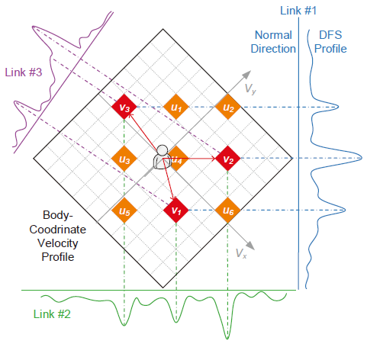
SYSTEM DESIGN
3D Velocity Profile – an extension of BVP [1]
[1] Yue Zheng, Yi Zhang, Kun Qian, Guidong Zhang, Yunhao Liu, Chenshu Wu, and Zheng Yang. Zero-Effort Cross-Domain Gesture Recognition with Wi-Fi. In Proceedings of the 17th Annual International Conference on Mobile Systems, Applications, and Services (MobiSys). ACM, 2019.

Slide 13
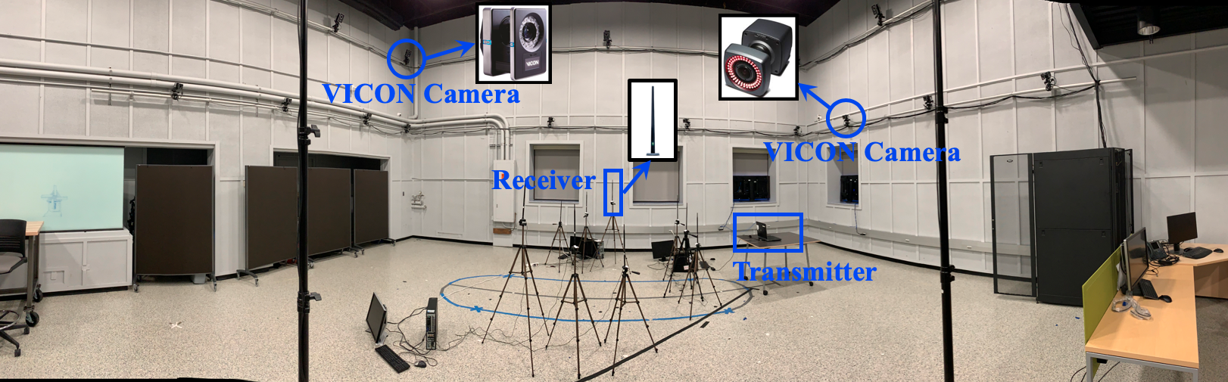
EVALUATION
Experimental Setting
Wi-Fi
1 Transmitter
3 Receivers
Channel 164
1000 Hz
VICON
21 VICON Cameras
17 markers/subject
Baseline
RFPose3D (Model)
Data Collection
16 daily activities

Slide 14
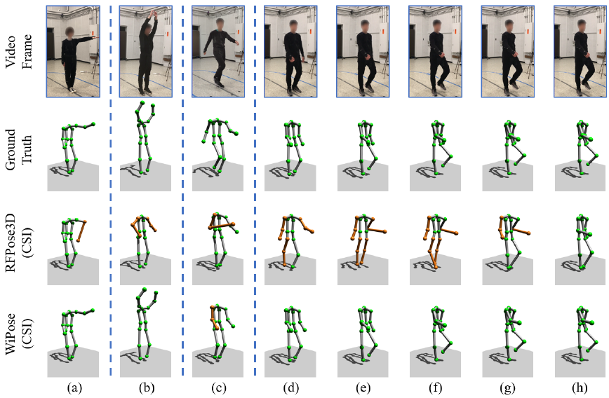
EVALUATION
Example

Slide 15
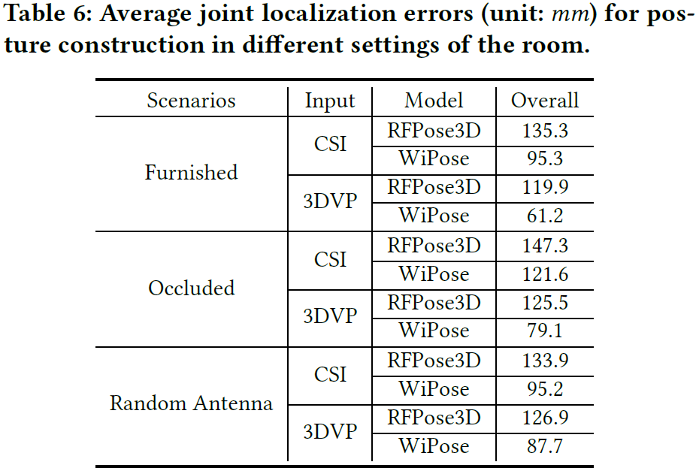
EVALUATION
Impact of dynamic environment

Slide 16
INSPIRATION
Using COTS Wi-Fi devices for real-time pose estimation
Expensive training system
Specific deployment
Extending to multi-people sensing

Slide 17
Thanks!

